Slide 1
Critical Sections
Necessary to avoid race conditions:
1. No two processes may be simultaneously inside their critical regions.
2. No assumptions may be made about speeds or the number of CPUs.
3. No process running outside its critical region may block other processes.
4. No process should have to wait forever to enter its critical region.
Tanenbaum & Woodhull, Operating Systems: Design and Implementation, (c) 2006 Prentice-Hall, Inc. All rights reserved. 0-13-142938-8
Notes:
1

Slide 2
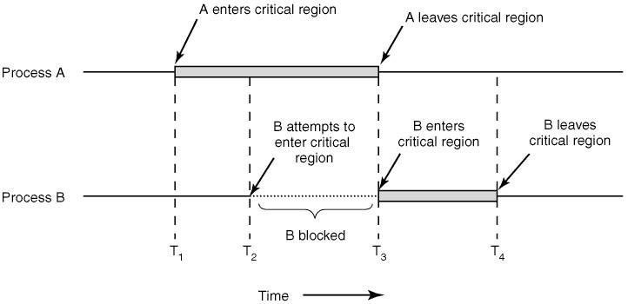
Mutual Exclusion with Busy Waiting
Figure 2-9 Mutual exclusion using critical regions.
Tanenbaum & Woodhull, Operating Systems: Design and Implementation, (c) 2006 Prentice-Hall, Inc. All rights reserved. 0-13-142938-8
Notes:
2

Slide 3
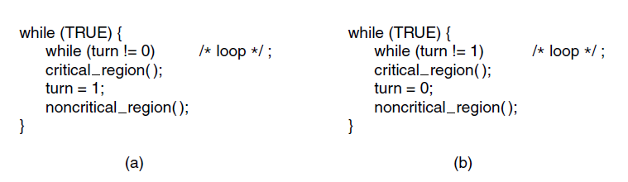
Mutual Exclusion with Busy Waiting: Strict Alternation
Figure 2-23. A proposed solution to the critical region problem. (a) Process 0. (b) Process 1. In both cases, be sure to note the semicolons terminating the while statements.
Tanenbaum & Bo,Modern Operating Systems:4th ed., (c) 2013 Prentice-Hall, Inc. All rights reserved.

Slide 4
Mutex Locks
OS designers build software tools to solve critical section problem
Simplest is mutex lock
Protect a critical section by first acquire() a lock then release() the lock
Boolean variable indicating if lock is available or not
Calls to acquire() and release() must be atomic
Usually implemented via hardware atomic instructions
But this solution requires busy waiting
This lock therefore called a spinlock

Slide 5
acquire() and release()
acquire() { while (!available)
; /* busy wait */
available = false;
}
release() {
available = true;
}
do {
acquire lock
critical section
release lock
remainder section
} while (true);

Slide 6
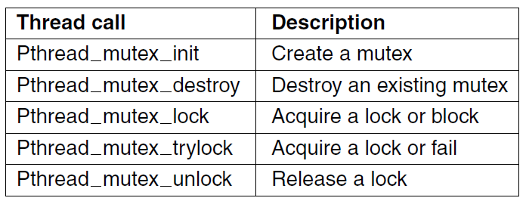
Mutexes in Pthreads (1)
Figure 2-30. Some of the Pthreads calls relating to mutexes.
Tanenbaum & Bo,Modern Operating Systems:4th ed., (c) 2013 Prentice-Hall, Inc. All rights reserved.

